Slide 1
Postal Frog
Art Bible

Slide 2
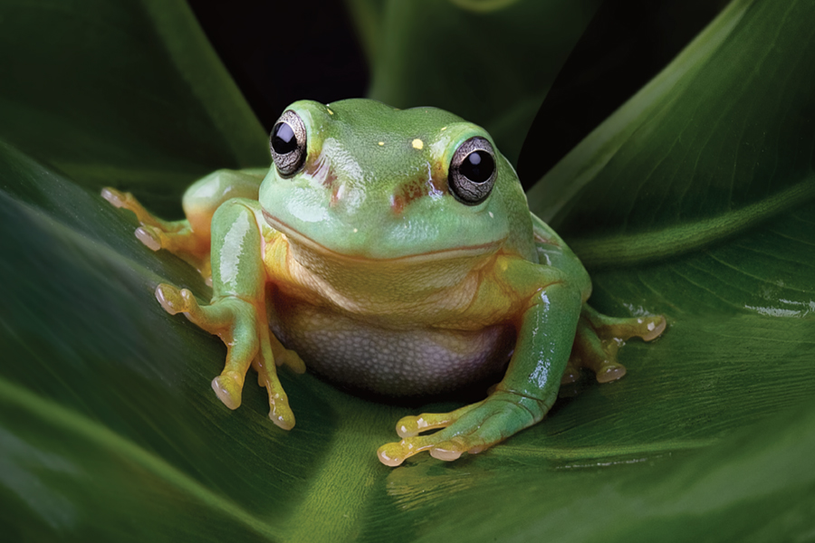
Overview
A frog platforms around a hedged in yard. Across a window, on top of a garden fountain and up the hedge rising higher to jump to the doorbell to report a delivery.

Slide 3
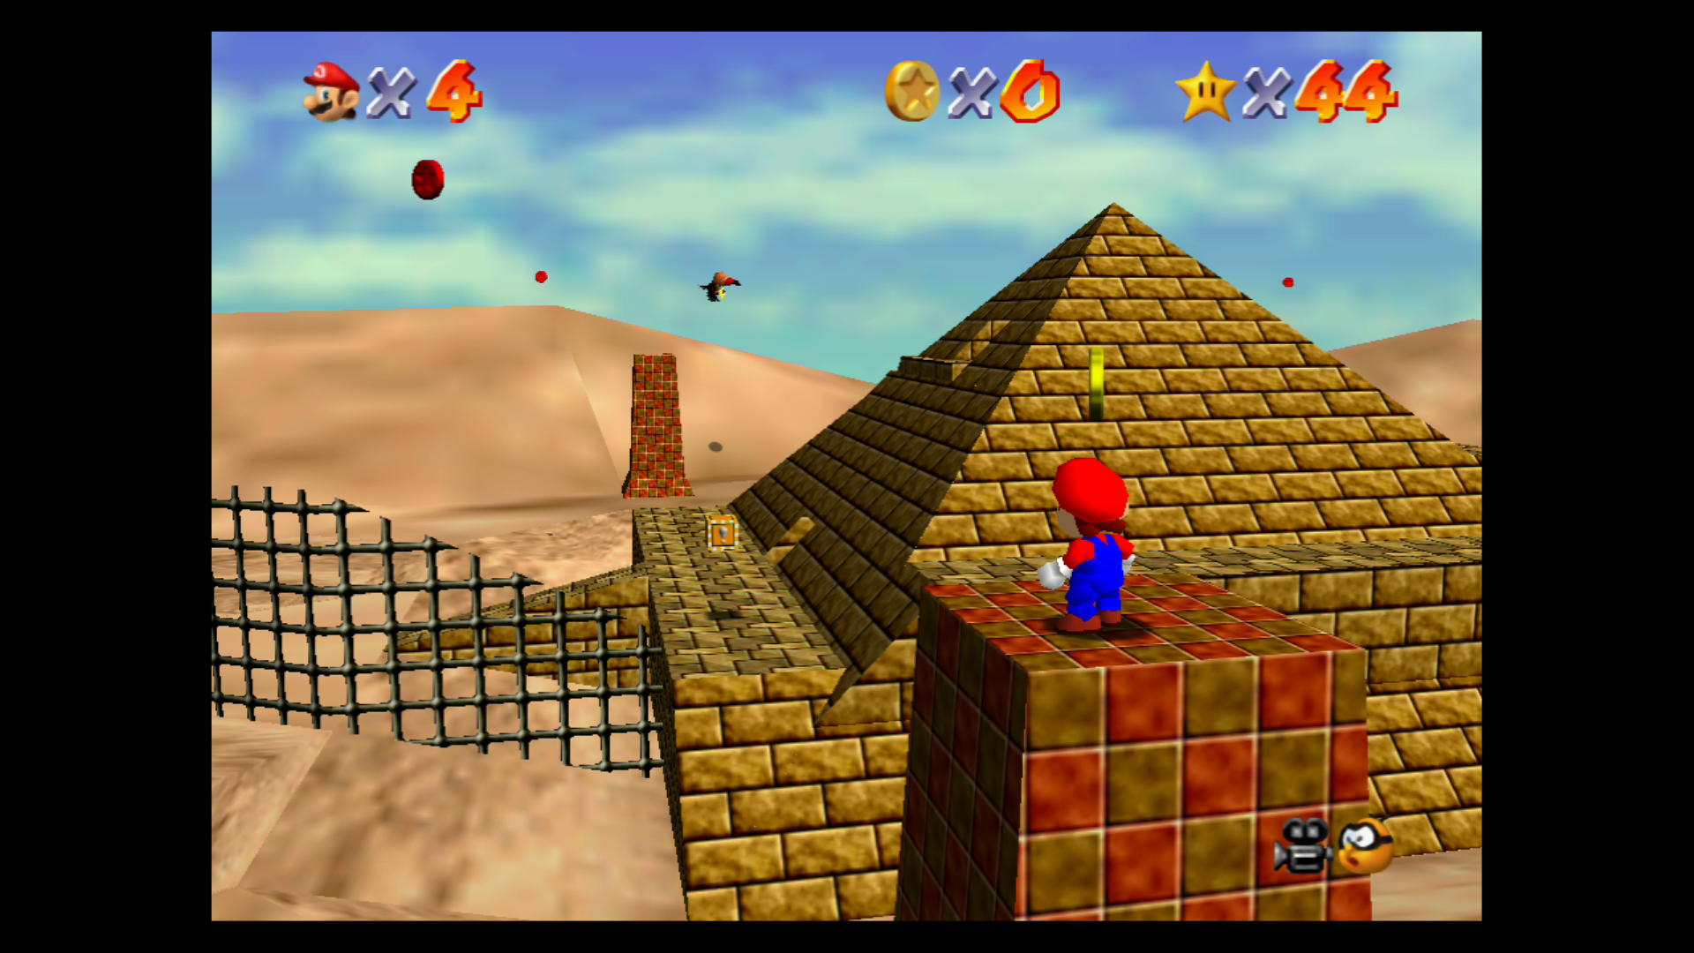
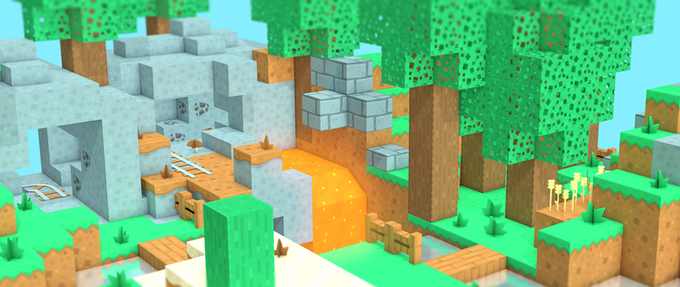

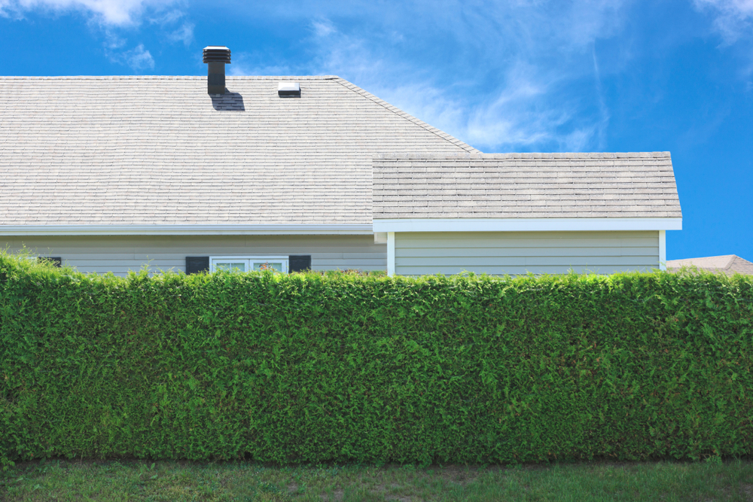
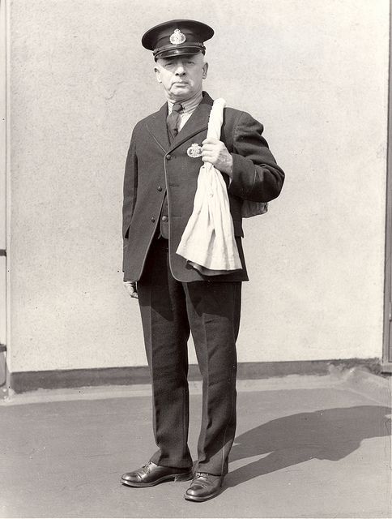
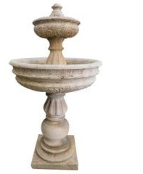
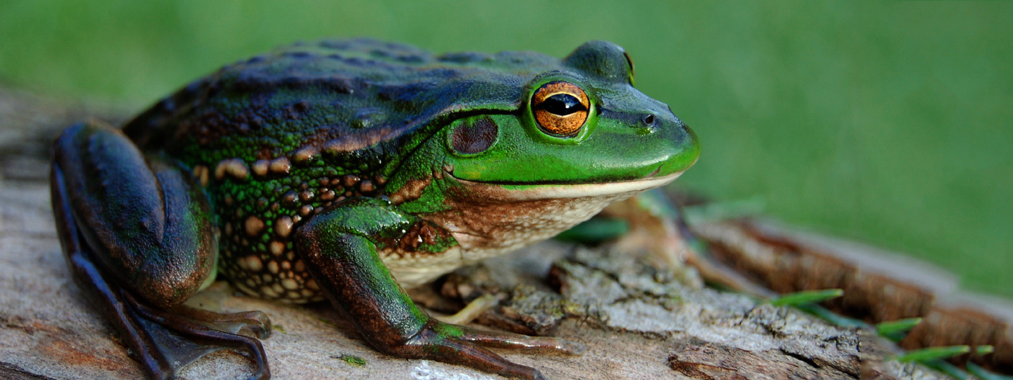
Mood Board
Bright
Peaceful
Rural
post

Slide 4
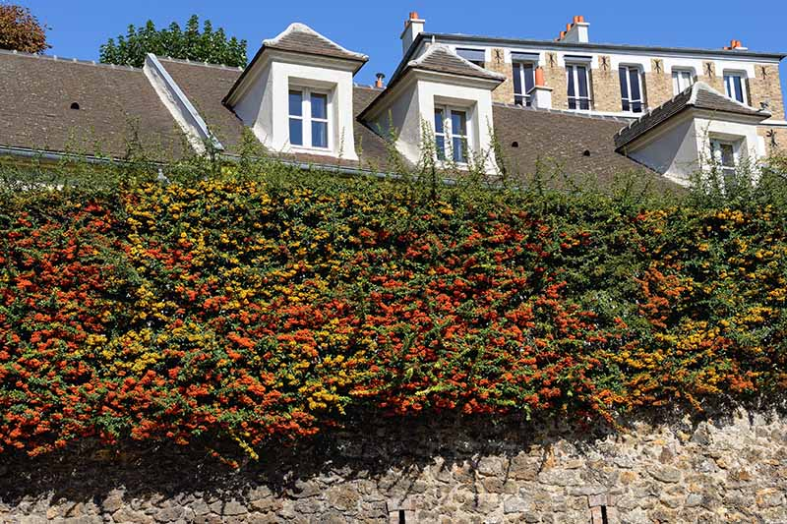
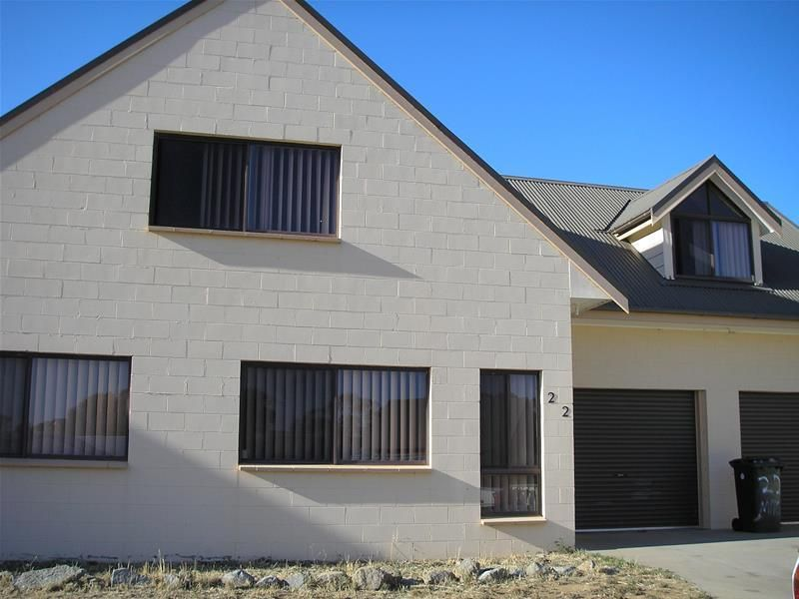
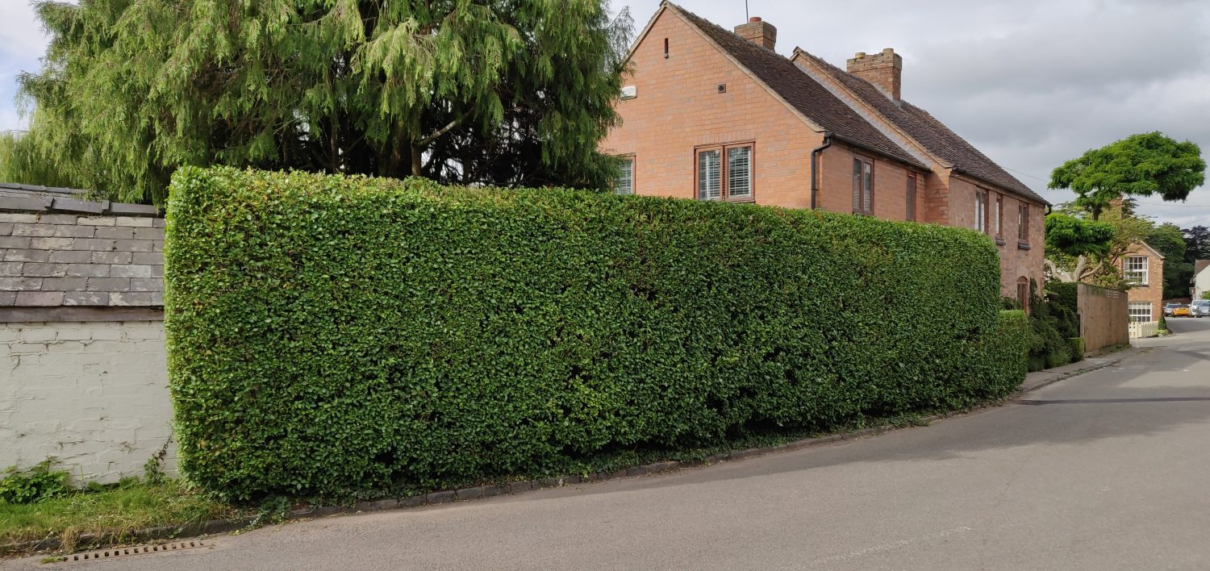
Environment
Hedge will cover the view of most of the outside world
Large subtle brick house with slanted roof
Thick consistently shaped green hedge

Slide 5
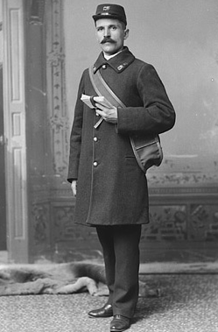
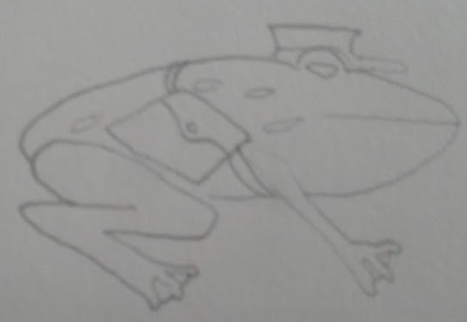
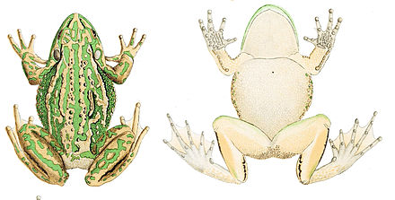
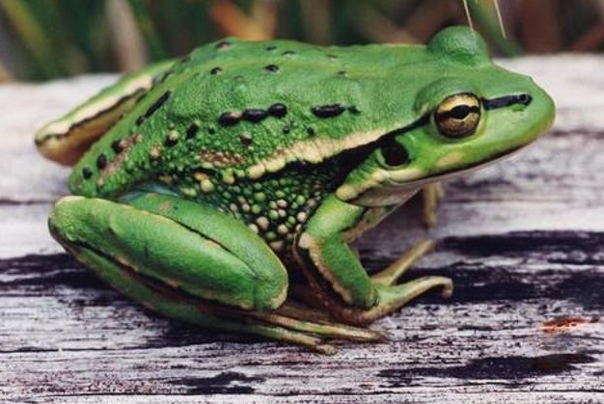
Character : Postal Frog
Postal Frog is the sole character of the game, the main character and the feature asset
Post officer cap and bag
Basic concept art
Bull frog breed for Postal Frog

Slide 6
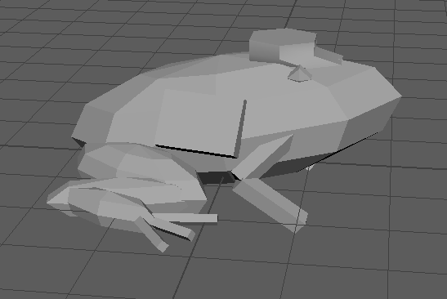
Character Greybox

Slide 7
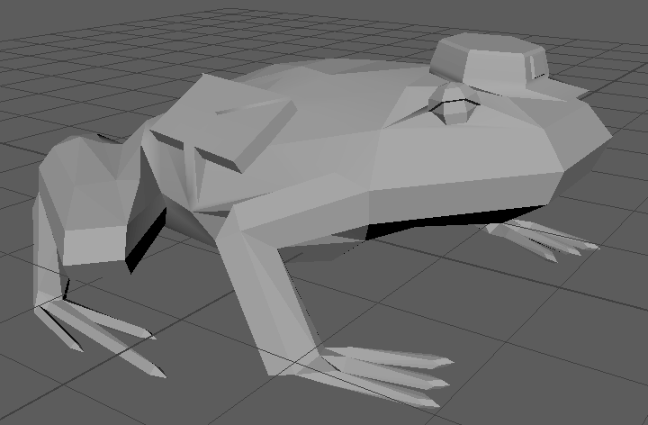
Character First pass

Slide 8
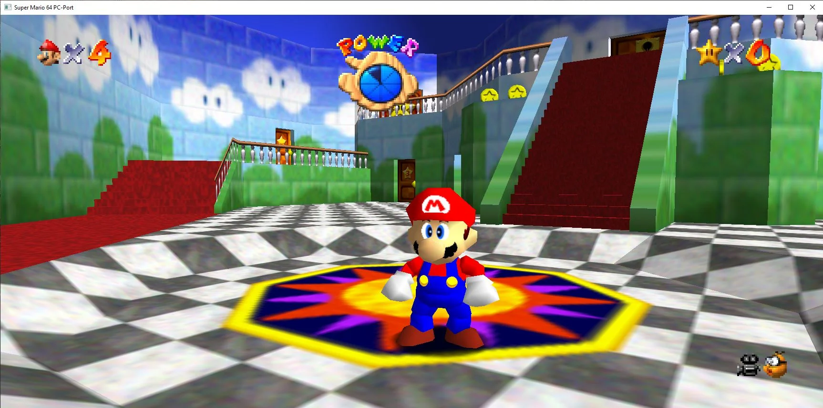
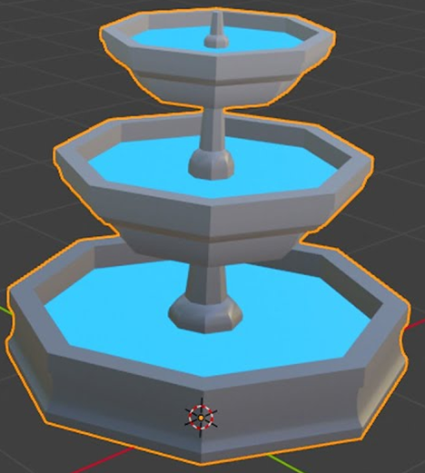
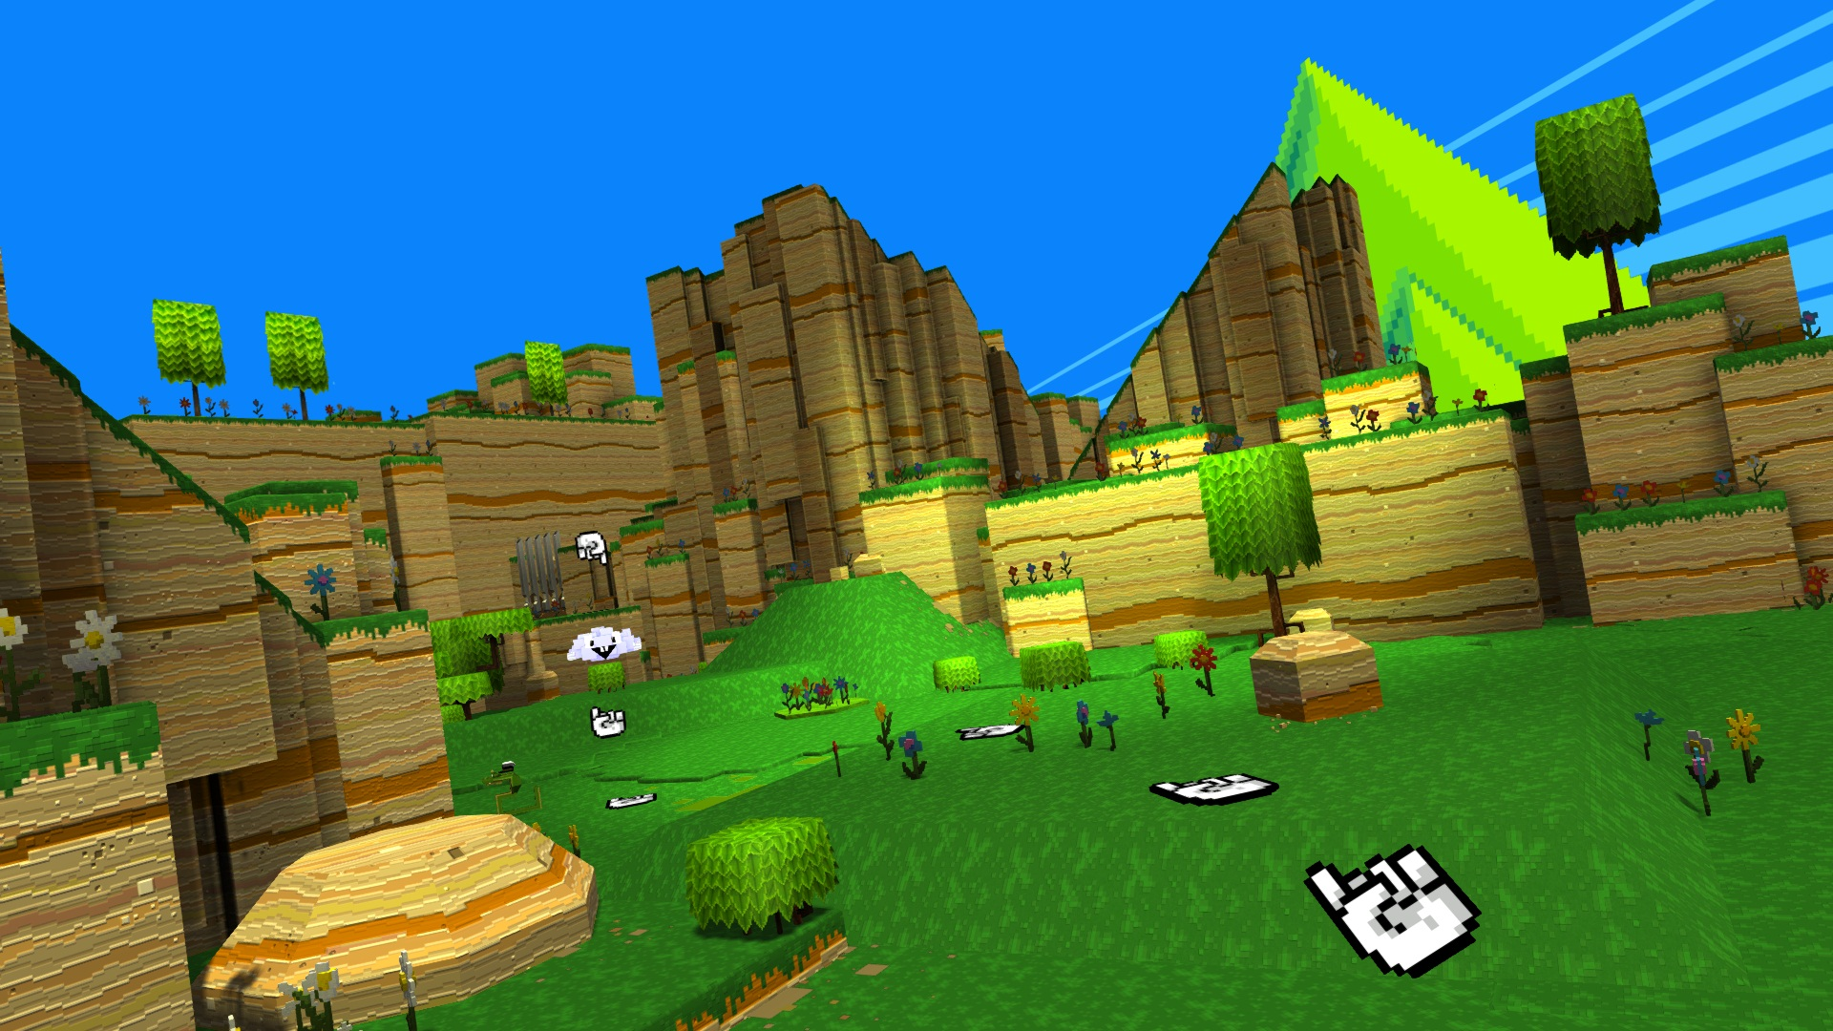
Models
Low poly shapes and textures

Slide 9
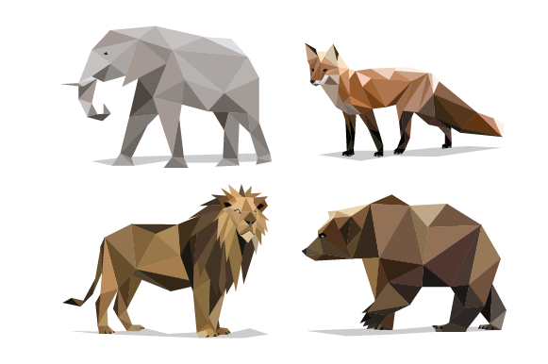
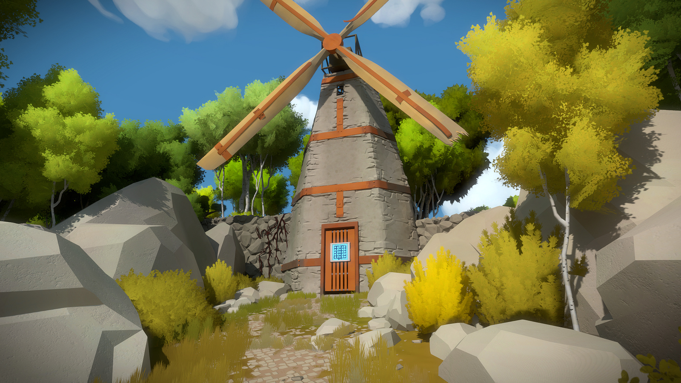
Textures
Organic models such as leaves, or the frog will have face-coloured styles
Rock and brick textures will have low detail

Slide 10
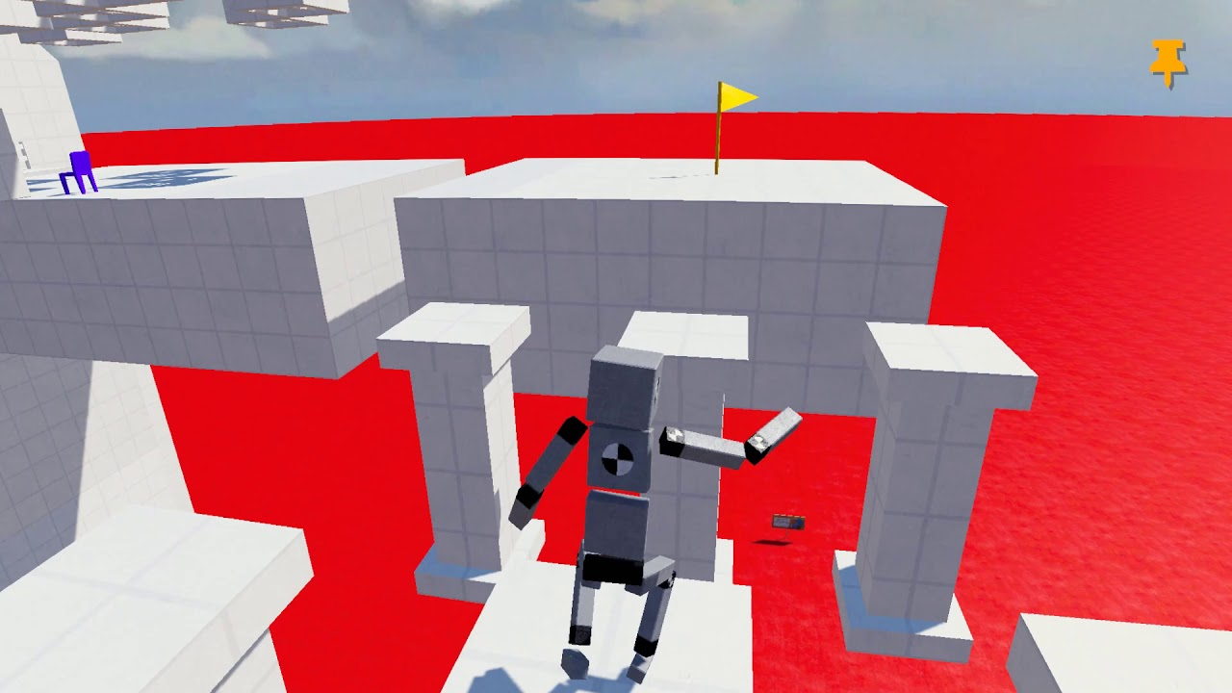
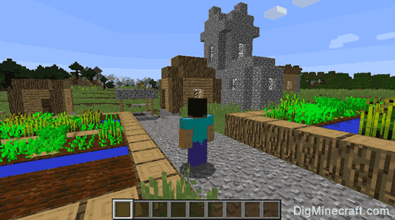
Camera
Camera will be third person following behind the players head.

Slide 11
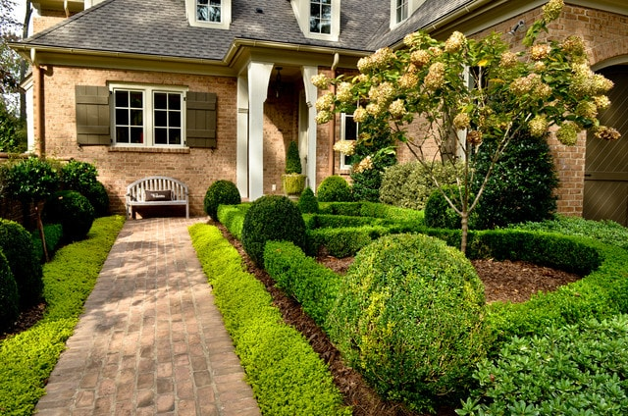
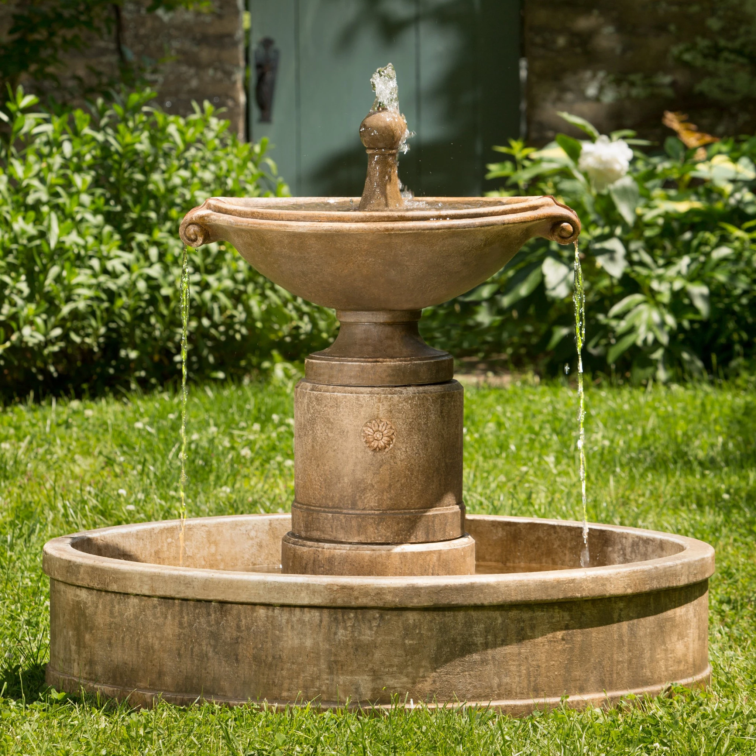
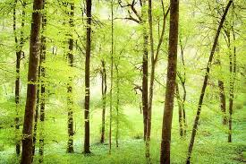
Lighting
There will be soft light to clearly show the scene of the level

Slide 12
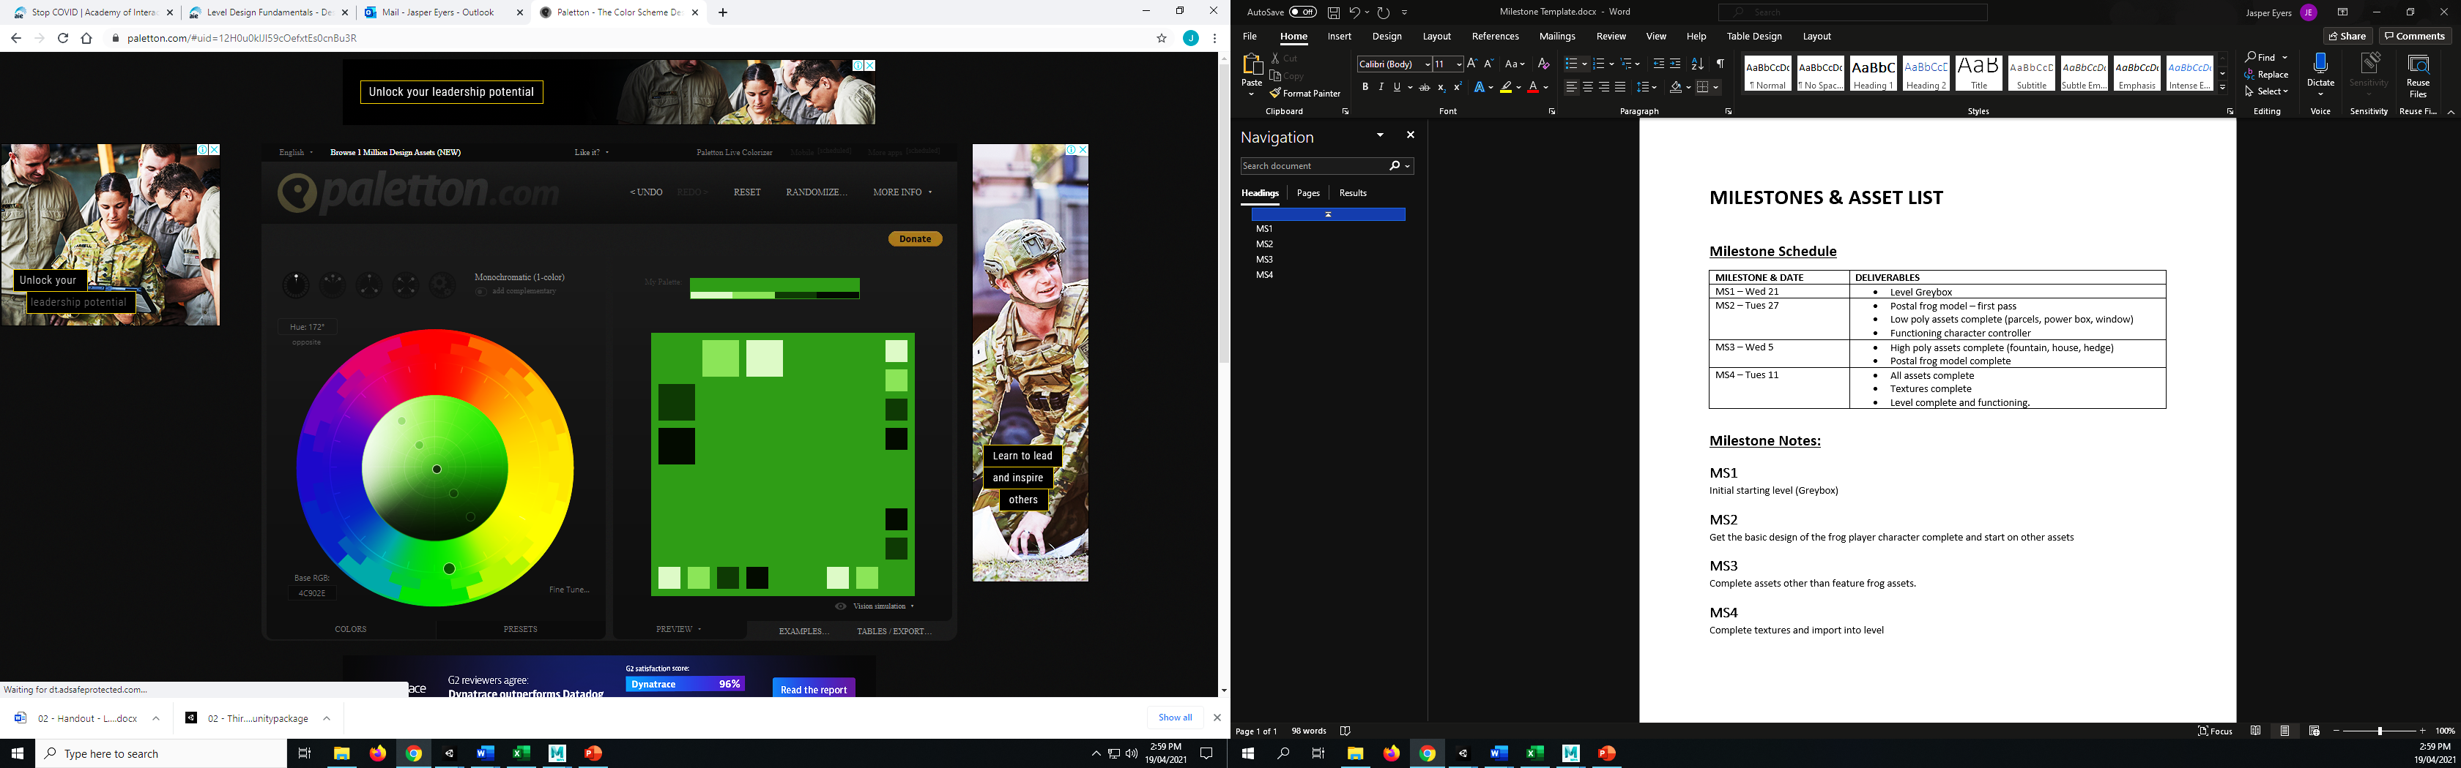
Colour Pallet
Level will be a mix of greens and greys and whites

Slide 13
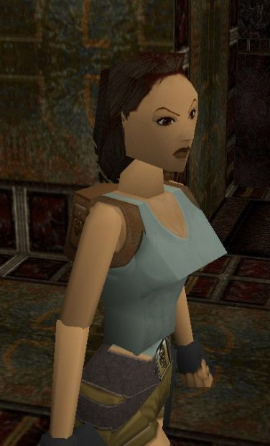
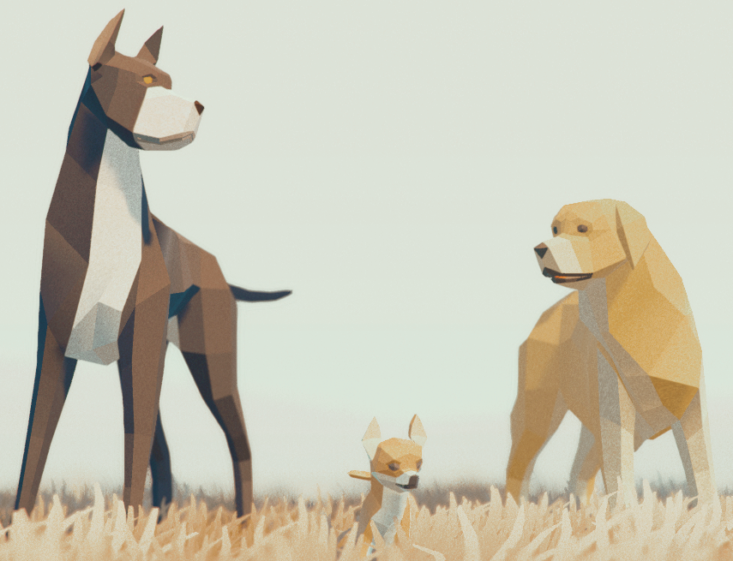
Level of Detail
Models will be low poly giving a minimum amount of geometry to show the necessary shape.

Slide 14
UI Style
N/A

Slide 15
Design rules
Leaf objects, fountain top and bottom outer edge, windowsill and window head must have a flat surface to act as a platform.
Packages and power box must have flat tops to act as platforms.

Slide 16
Art tools
Maya: Modelling all in game models and UV unwrapping textured models
Photoshop: creating

Slide 17
Technical guidelines

